Slide 1

Department of Computer Science &Engineering Artificial Intelligence & Machine Learning
A.P. Shah Institute of Technology G.B.Road,Kasarvadavli, Thane(W), Mumbai-400615 UNIVERSITY OF MUMBAI Academic Year 2022-2023

Slide 2
Synopsis On:
Admin Controlled Webstore Interface.
Submitted in partial fulfillment of the degree of Bachelor of Engineering(Sem-4) in Computer Science & Engineering
Artificial Intelligence and Machine Learning
Presented By: Kaiser Momin (21106009) Under Guidance of:
Devesh Sali (21106016) Prof. Jaya Gupta Yash Malvade (21106032)
Ratnakar Pisal (21106041)

Slide 3
Abstract
The admin-controlled webstore interface with machine learning/deep learning integration is a project aimed at improving the shopping experience for customers and optimizing the operations of online stores.
The Project Provides a Web Store Interface based on the Django MTV (Model Template View) Architecture.
It enables the creation of users at the back end and denies most possible external penetration methods into the website server.

Slide 4
Problem Definition
Despite the increasing popularity of e-commerce, businesses face challenges in providing a personalized shopping experience to their customers. Customers often struggle to find products that are relevant to their needs, resulting in low engagement, reduced customer loyalty, and lower revenue for businesses. Additionally, businesses struggle to manage their online store effectively, lacking the necessary tools to categorize products, identify trends, and optimize the search and browsing experience. Therefore, the need exists to develop an admin-controlled webstore interface with machine learning/deep learning integration that provides businesses with the tools to analyze customer data and provide personalized product suggestions. This technology would also allow businesses to manage their online store more efficiently, providing them with real-time analytics to optimize their operations and make data-driven decisions.

Slide 5
Objectives
To build a fully functional Locally Hosted Web-Store Interface.
To create the following features:
Sign-In and Sign-Out options
Cart Options
Administrator Page(Managed Via Django Administrative Framework)
Completely Editable SQL Catalog table (Managed Via Django Administrative Framework)
To create Categories and Products within those categories and an interface to access these specific Categories.
Applying machine learning To build a recommendtion system.

Slide 6
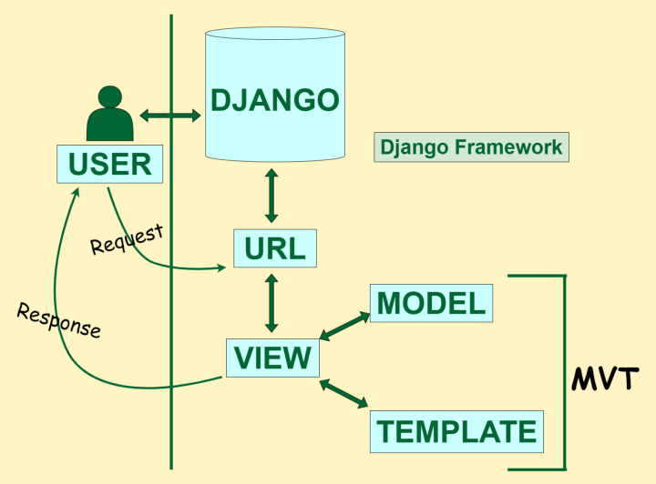
Scope
The use of Django Framework allows for easy access to the Product Catalog and Editing Items within the Catalog.
This Store Interface is Usable in any local store to easily manage the inventory and manage a checklist of products sold.

Slide 7
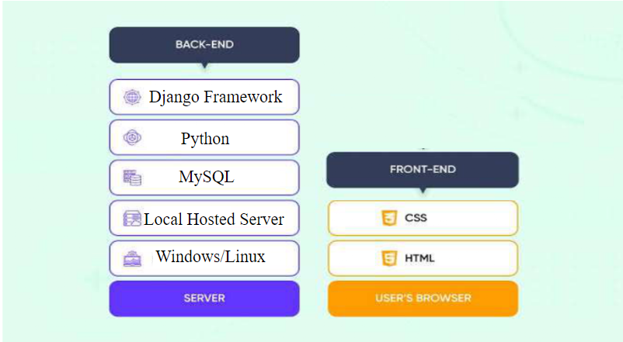
Technology Stack

Slide 8
Applications
Since the interface of the website is based on the Django Framework it is Ideal for E-commerce usage but some other aspects of the project design can be used for easy online inventory management.
All Backend updates are recorded directly via the framework and hence it can also be used for quick monitoring.
Furthermore it provides a safe and secure admin-controlled Backend.
We have added a recommendation System which helps to suggest the customer

Slide 9

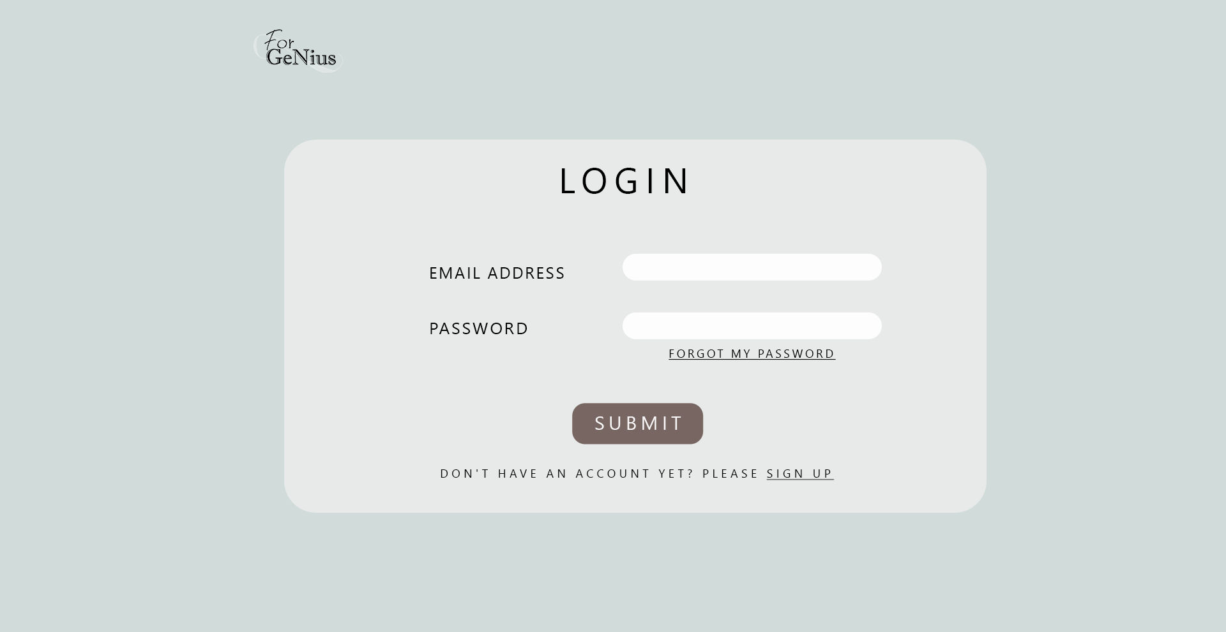
Login Page:
Logo:

Slide 10
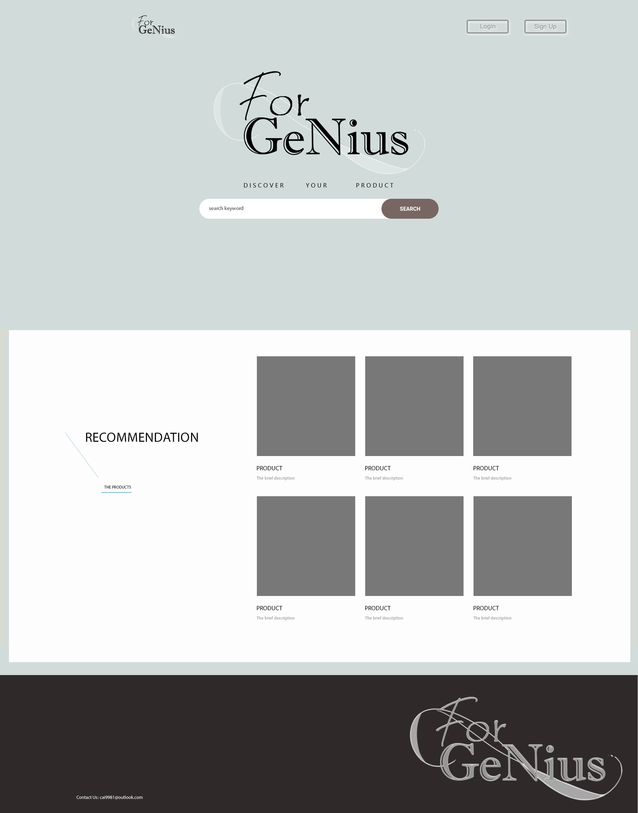

Guest Page :
User Page :

Slide 11
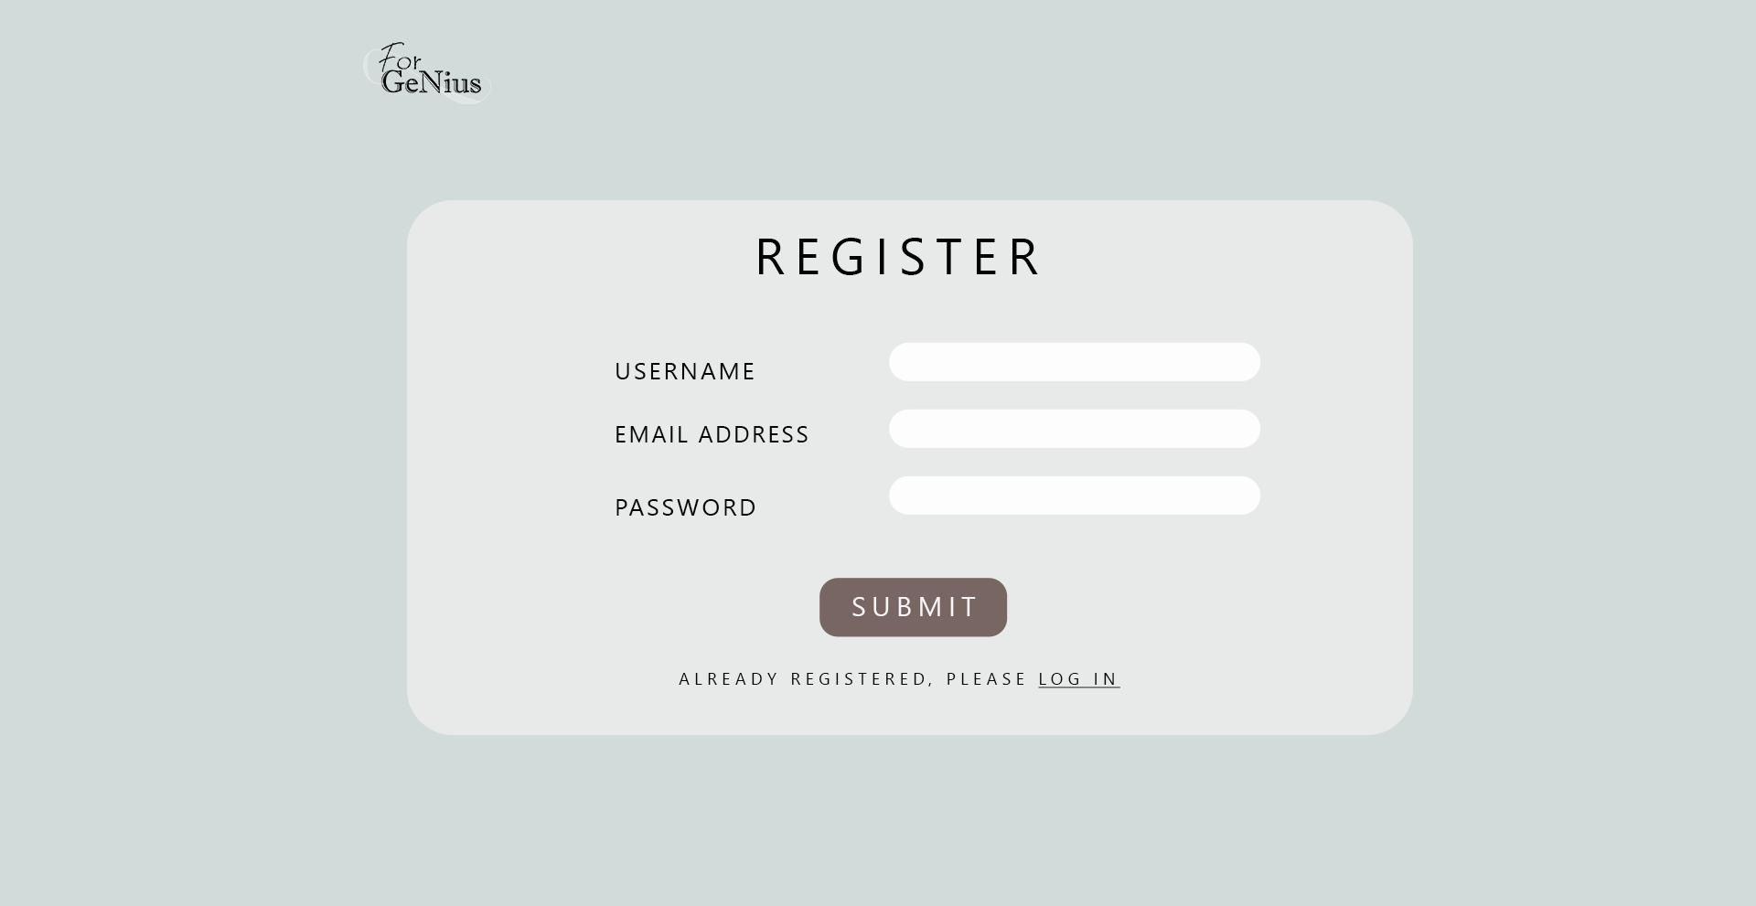
Registration Page :

Slide 12
References
Software:
i) https://www.python.org/downloads/ (for python 3.11.0)
ii) https://code.visualstudio.com/docs/?dv=win (for VS code)
iii) https://www.sqlite.org/download.html (for independent SQLite usage)
iv) Extensions in VS code:
DB SQLite by alexcvzz
Atom One Dark Theme by Mahmoud Ali

Slide 13
References
Websites:
i) https://python.plainenglish.io/the-mvt-design-pattern-of-django-8fd47c61f582
ii) https://www.geeksforgeeks.org/top-10-reasons-to-choose-django-framework-for-your-project/
iii)https://uvik.net/blog/django-vs-ruby-on-rails/#:~:text=If%20we%20compare%20the%20two,Flexibility.
iv)https://www.jobsity.com/blog/5-reasons-why-mysql-is-still-the-go-to-database-management-system
v)https://www.geeksforgeeks.org/django-project-creating-a-basic-e-commerce-website-for-displaying-products/

Slide 14
References
Videos:
i) https://www.youtube.com/watch?v=rHux0gMZ3Eg
ii) https://www.youtube.com/watch?v=YZvRrldjf1Y
iii) https://www.youtube.com/watch?v=_uQrJ0TkZlc

Slide 15
Thank You

